Slide 1

Design Pattern
Soft Bodies
Group
Present by Amir Arsalan Yavari

Slide 2

Repeated challenges
Abstraction
Encapsulation
Polymorphism
Inheritance
Class
Object
How to make sure we have only one instance of an object?
How can the rest of the objects be informed by a change in one object?
How to dynamically execute one of several algorithms?
Etc …

Slide 3
CONTENTS OF THIS PRESENTATION
Types of Design Patterns?
Design Patterns classifications
Singleton
Problem
Class diagram
Pseudocode
Strategy
Problem
Class diagram
pseudocode
Observer
Problem
Class diagram
Pseudocode
Decorator
Problem
Class diagram
pseudocode
Resources

Slide 4
01
Creational Patterns
02
Structural Patterns
03
Behavioral Patterns
design patterns that deal with object creation mechanisms and are used in situations when basic form of object creation could result in design problems or increase complexity of a code base.
design patterns that ease the design by identifying a simple way to realise relationships between entities or defines a manner for creating relationships between objects.
design patterns that ease the design by identifying a simple way to realise relationships between entities or defines a manner for creating relationships between objects.

Slide 5
Classification of Patterns
 |  | Purpose
 |  | Creational | Structural | Behavioral
Scope | Class | Factory Method | Adaptor | Interpreter Template Method
 | Object | Abstract Factory Builder Prototype Singleton | Adaptor bridge Composite Decorator Facade Flyweight Proxy | Chain of Responsibility Command Iterator Mediator Memento Observer State Strategy Visitor
These are some patterns. Not all of them

Slide 6
Some example
Singleton
Strategy
Observer
Decorator

Slide 7
Singleton Pattern
It is Creational and related to Objects… Example: network manager

Slide 8
challenge!
We want to make sure we have only one instance of an object?

Slide 9



Using static?
Losing referencing the object
Losing inheritance
Stored in stack instead of heap

Slide 10
Therefore, it is recommended to store object inside of the class itself

Slide 11
Class Diagram
Singleton
Instance: Singleton
Singleton( ) getInstance( ) : Singleton

Slide 12
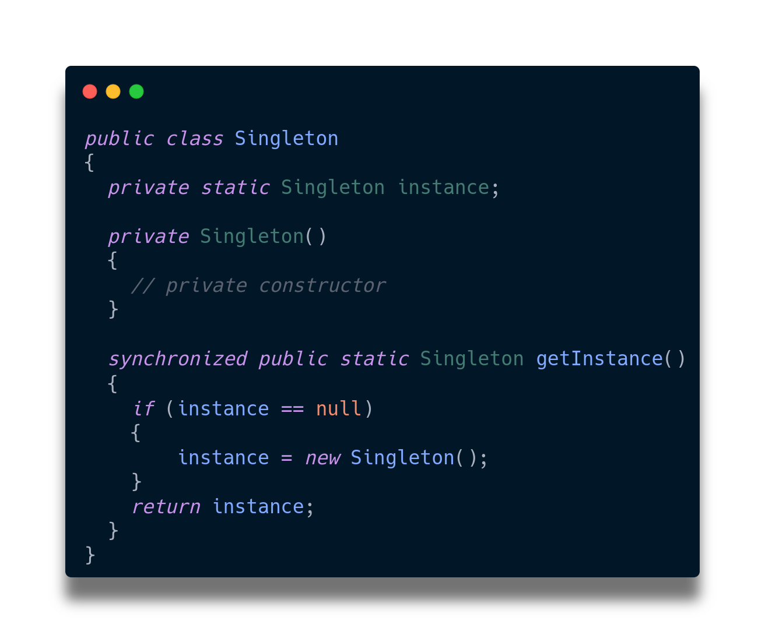
Singleton Patterns

Slide 13
Some example
Singleton
Strategy
Observer
Decorator

Slide 14
Strategy Pattern
It is Behavioral and related to Objects… Example: Layoutmanager in java Multiplatform Application

Slide 15
challenge!
How to to change object behavior in run-time?

Slide 16


Using Consecutive conditions?
Losing OOP principles
Using Inheritance or Interface?
Can not changing in run-time

Slide 17
Therefore, it is recommended to HAS-A relation instead of IS-A
(Exactly using Composition instead of Interface)

Slide 18

Class Diagram
Context
strategy: Strategy
setStrategy (Strategy s) performStrategy ( )
<<interface>> Strategy
doAlgorithm ( )
StrategyA
doAlgorithm ( )
StrategyB
doAlgorithm ( )
StrategyC
doAlgorithm ( )

Slide 19
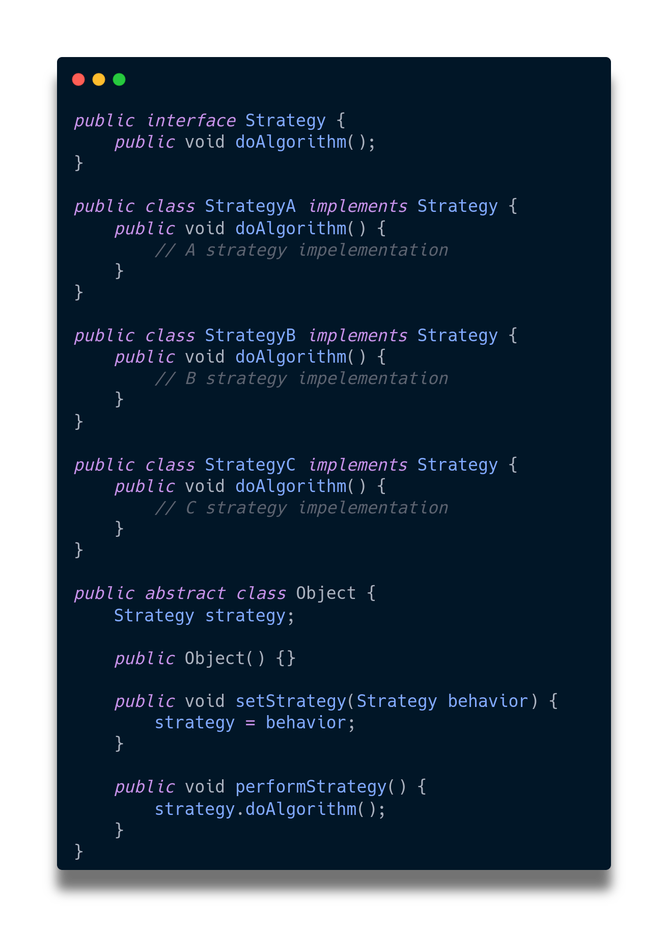
Strategy Patterns

Slide 20
Some example
Singleton
Strategy
Observer
Decorator

Slide 21
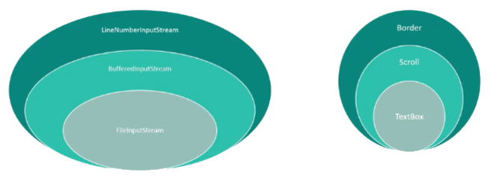
Observer Pattern
It is Behavioral and related to Objects… Example: using in java I/O
Expanding elements in UI

Slide 22
challenge!
By changing one of the objects, other objects be informed of that change

Slide 23
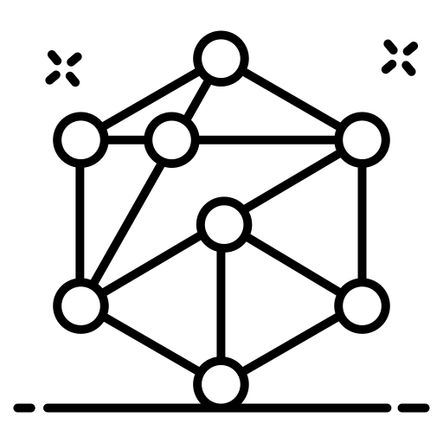
Storing Reference of an Object
Make objects tightly coupled
NOTE: Tightly coupled mean There is high convectivity and dependency between objects

Slide 24
Therefore, it is recommended to registering if an event is important for object…

Slide 25
Class Diagram
<<interface>> Subject
registerObserver ( ) removeObserver ( ) notifyObserver ( )
<<interface>> Observer
update
observer
ConcreteSubject
registerObserver ( ) {...} removeObserver ( ) {...} notifyObserver ( ) {...} getState setState
ConcreteObserver
update ( )
subject

Slide 26
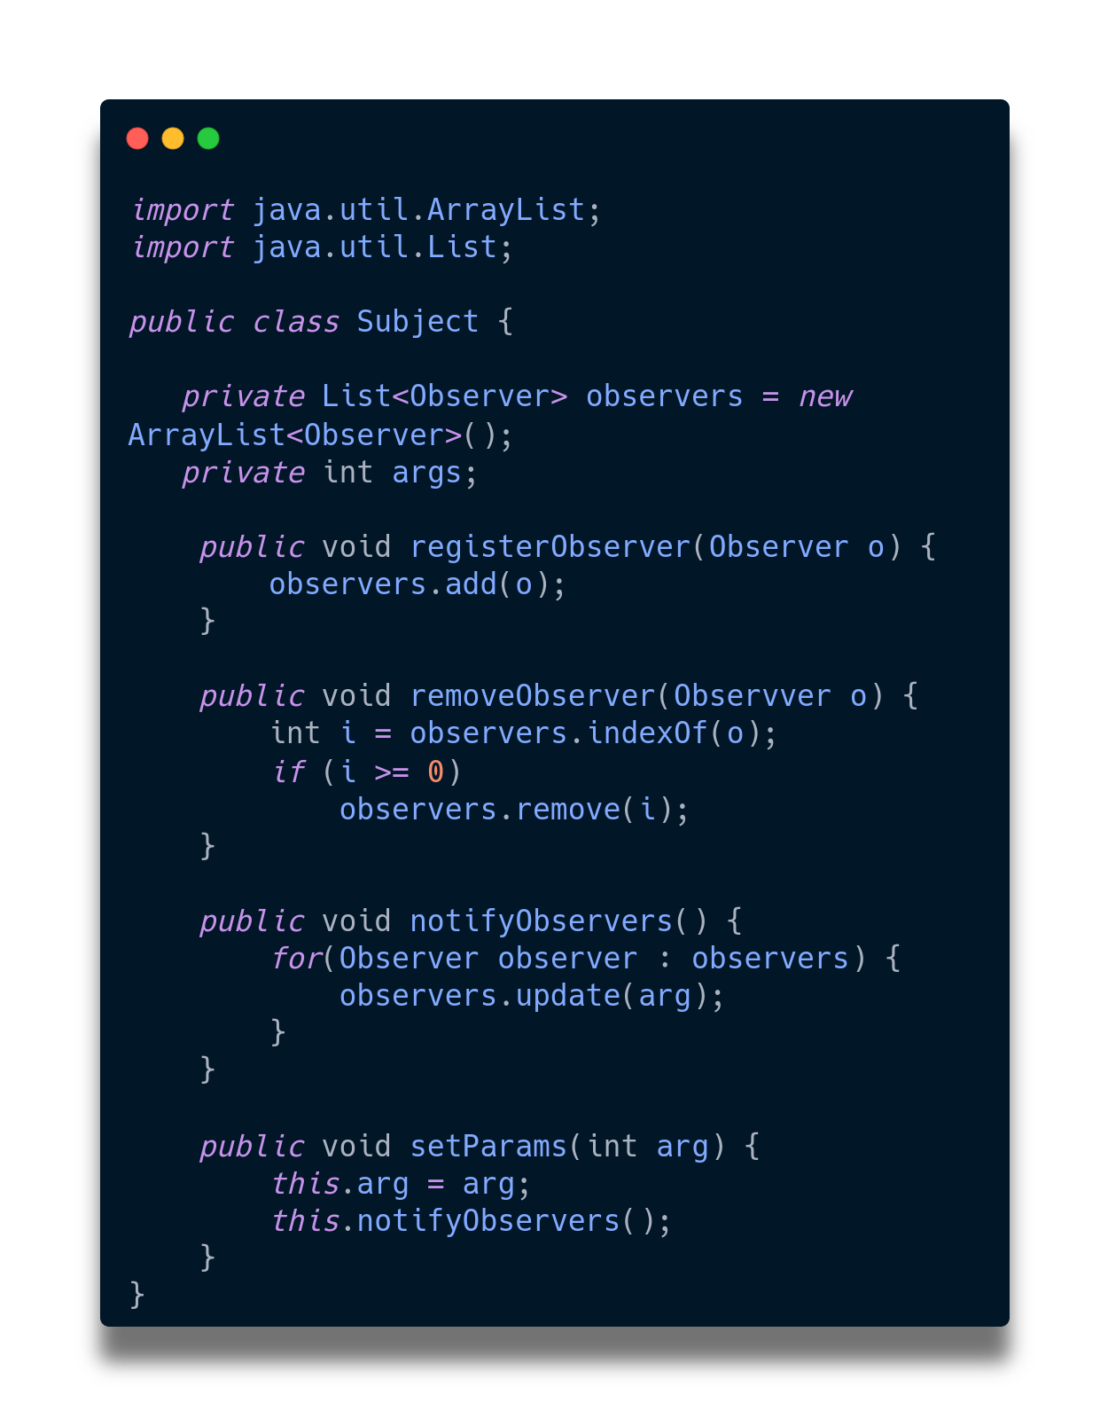
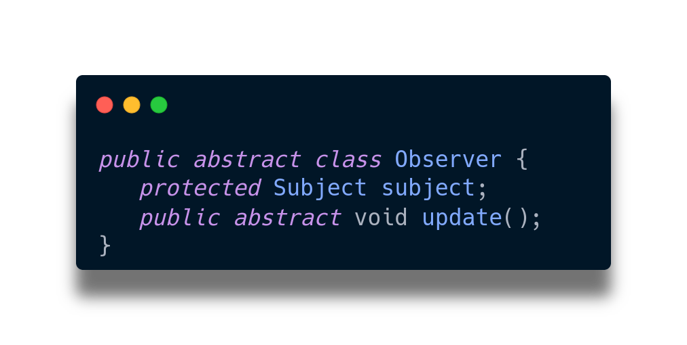
Observer Patterns

Slide 27
Some example
Singleton
Strategy
Observer
Decorator

Slide 28
Decorator Pattern
It is Structural and related to Objects… Example: data binding in UI like reactjs & vuejs
Events in C# …

Slide 29
challenge!
Dynamically adding more features to the objects

Slide 30


Is the Inheritance enough?!
Many classes that confuse us
Using attribute to save states
Have no control for preventing acquiring state if another one happened

Slide 31
Therefore, it is recommended to use Decorator. Using composition and HAS-A

Slide 32
Class Diagram
Component
methodA ( ) methodB ( )
Decorator
wrappedObj: Component
methodA ( ) methodB ( )
ConcreteComponent
methodA ( ) methodB ( )
ConcreteDecorator
wrappedObj: Component
methodA ( ) methodB ( ) newBehavior ( )
Decorator
wrappedObj: Component
methodA ( ) methodB ( ) newBehavior ( )

Slide 33
OUR CREATIVE PROCESS
component
Decorator
ConcreteDecorator
Decorator

Slide 34
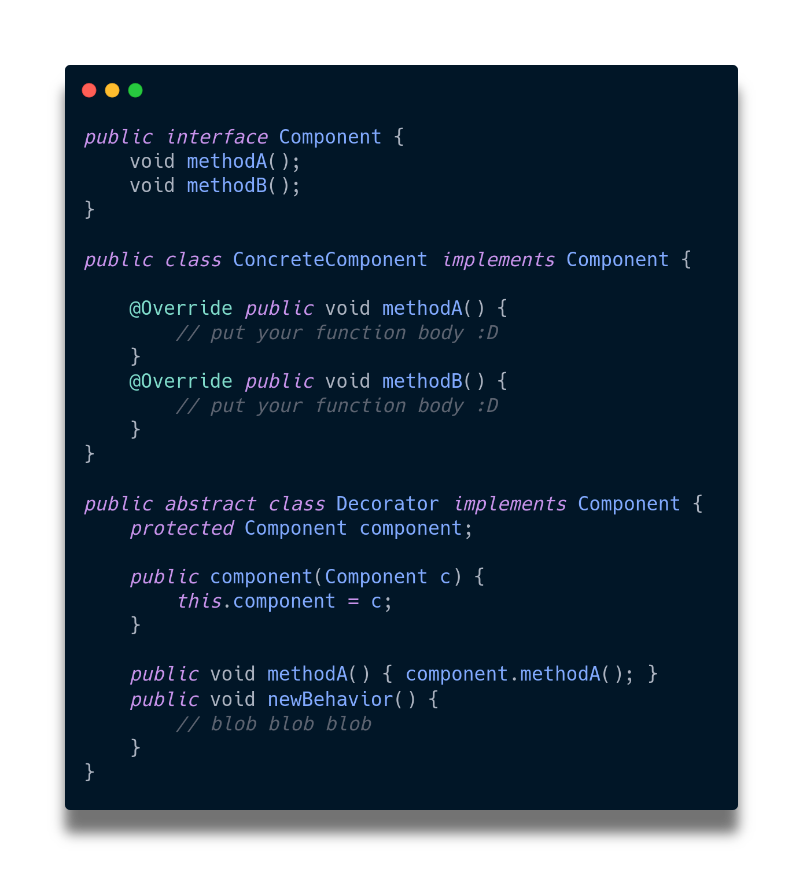
Decorator Patterns

Slide 35





THANKS!
Do you have any questions? amirarsalan.yavari@ec.iut.ac.ir +98 914 0127 683
Please keep this slide for attribution.

Slide 36
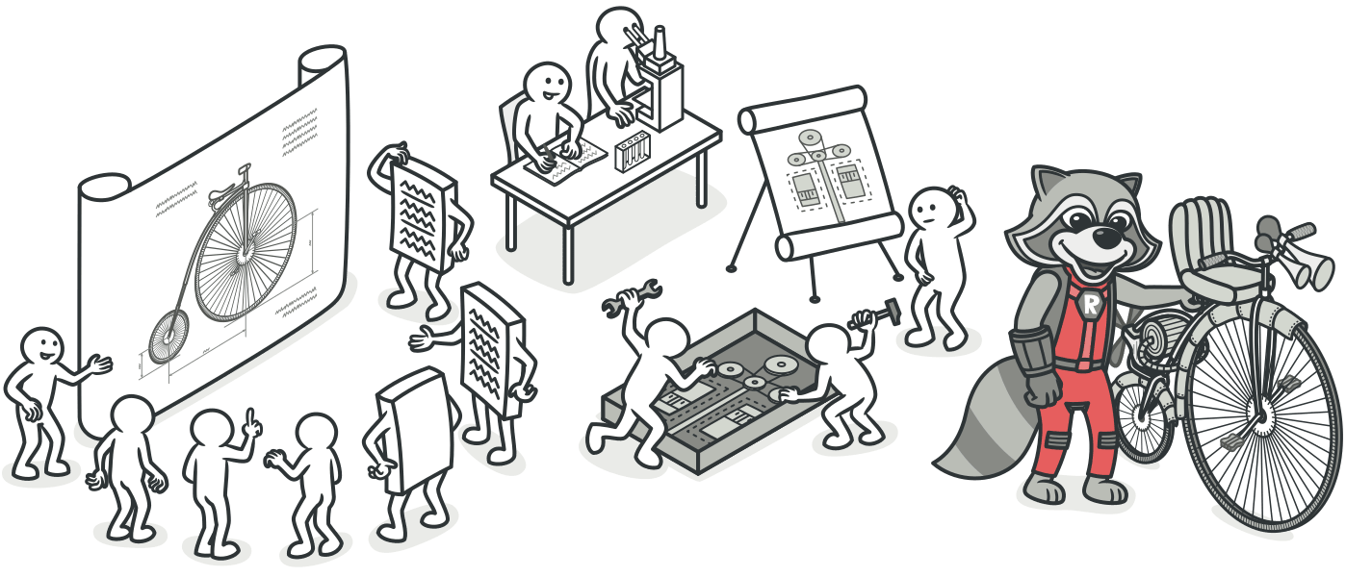
Learn More: you can learn more in the https://refactoring.guru/design-patterns Also design patterns handbook description and implementation of the most of them exist in https://www.geeksforgeeks.org/software-design-patterns/

Slide 37
ALTERNATIVE RESOURCES
https://refactoring.guru/design-patterns
https://www.digitalocean.com/community/tutorials/gangs-of-four-gof-design-patterns

